Slide 1
GRA_Net: Age and Gender From Facial Images
Vipindas K
S7, CSE B

Slide 2
INTRODUCTION
In the more recent years, researchers have been started exploring the domain of convolutional neural network (CNN) based deep learning architectures for the task of age and gender prediction which help in automatic feature extraction from the input images.
To improve such feature extraction ability, use of the long short-term memory (LSTM) units inserted between Residual Networks (ResNets) has also been found.
In this paper, we have proposed an architecture which harnesses the capabilities of both classification and regression to solve the tasks of age estimation and gender prediction from the facial images.

Slide 3
SCHEMATIC DIAGRAM
IMAGE
Gender Classification
Age Classification
Binary Classification Model
Multi Class Classification Model
Regression Model
GRA_NET
GRA_NET
GRA_NET
Class wise output probabilities for two classes(male or female)
Class wise output probabilities for various age range (0-9, 10-19…)
Value ranging from 0 to 9
Clow * 10 + V
Gender
Age

Slide 4
DATASETS

Slide 5
FG-NET AGING DATASET
FG-NET (Face and Gesture Recognition Network)
The dataset consists of 1002 images of 82 different subjects with their ages varying from newborns to 69 years old.
Some challenging issues:
quality of images
depends on the photographic skills of the photographer
the quality of the imaging equipment
In particular, information about the age, gender, expression, pose, image quality and occlusions like moustaches, beards, hats or spectacles was recorded.

Slide 6
AFAD DATASET
The Asian Face Age Dataset (AFAD) was developed for evaluating the performance of various age estimation models and architectures.
It contains more than 160K facial images along with their corresponding age labels.
Ages varying from 15 to 40.
The AFAD dataset was built by collecting photos of users from a particular social network called RenRen Social Network (RSN).

Slide 7
WIKIPEDIA AGE DATASET
The most popular 100,000 actors as listed on the IMDb website were taken and various metadata related to that person like date of birth, name and gender were (automatically) crawled from their profiles.
The images which were not timestamped (the date when the photo was taken) were removed as they will not have any age information in them.

Slide 8
UTKFace DATASET
Age span range: 0 to 116 years
The dataset consists of more than 20K face images with metadata annotations of age, gender, and ethnicity.
The images cover large variation in illumination, occlusion, pose, facial expression, resolution, etc.
The dataset finds its use in a variety of tasks ranging from face detection, age estimation to age progression/regression and landmark localization, etc.

Slide 9
AdienceDB DATASET
The images present in AdienceDB dataset were crawled from Flickr.com albums, obtained by automatic upload from smartphones.
Many faces in the albums appeared at different roll angles and to avoid missing such faces, the process of detecting faces was applied to each and every image, rotated 360◦ degrees in steps of 5◦ increments.
Finally, the images were manually labeled for gender, age

Slide 10
METHODOLOGY

Slide 11
GATED RESIDUAL ATTENTION NETWORK
The Residual Attention Network used here has been constructed by combining and stacking multiple Attention blocks. Every block is further subdivided into two branches namely the Mask branch and the Trunk branch.
The output of Attention: Oi,c(X) = Ki,c(X) ∗ Pi,c(X)
where, i ranges over all spatial positions and c ∈ {1, . . . ,C} is the index of the channel.
In the soft mask branch, the gradient of mask for the input feature: ∂K(X, θ) ∂φ P(X, φ) = K(X, θ) ∂P(X, φ) ∂φ
where, θ are the mask branch parameters and φ are the trunk branch parameters.

Slide 12
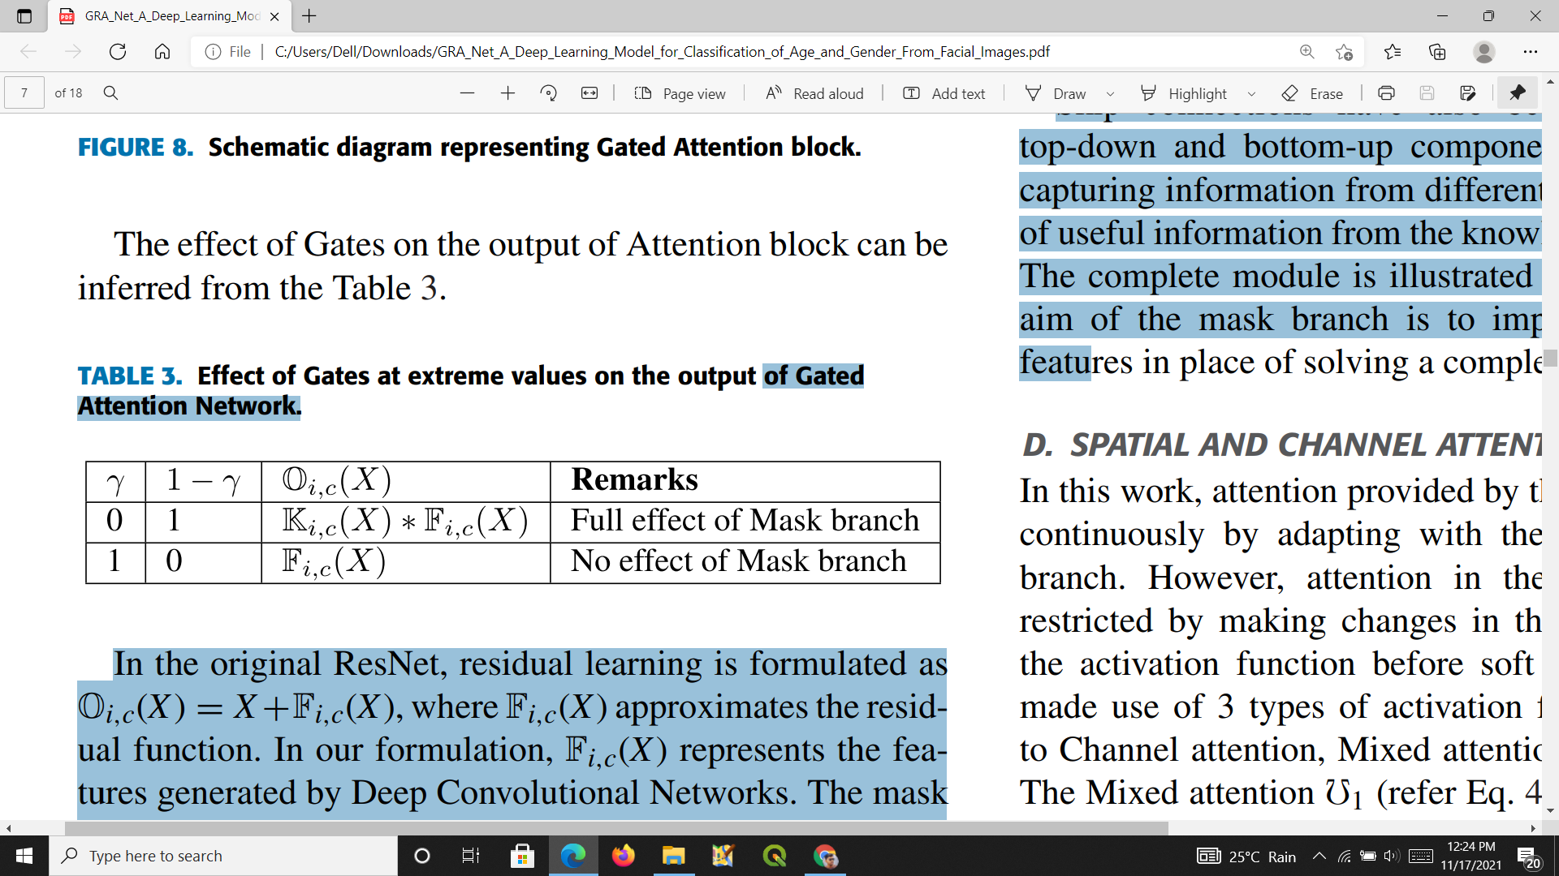
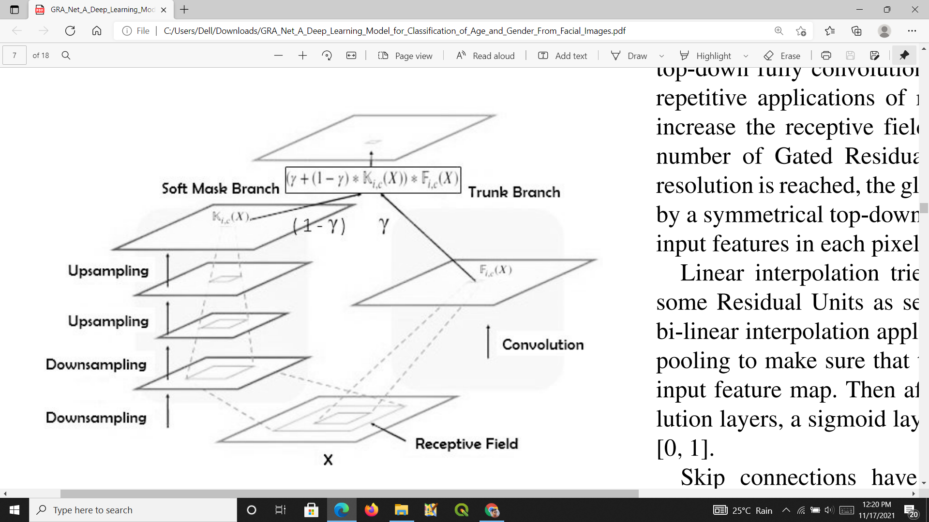
GATED RESIDUAL ATTENTION LEARNING
Oi,c(X) = (γ + (1 − γ ) ∗ Ki,c(X)) ∗ Fi,c(X)

Slide 13
SPATIAL AND CHANNEL ATTENTION
In this work, attention provided by the mask branch changes continuously by adapting with the features of the Trunk branch. However, attention in the mask branch can be restricted by making changes in the normalization step of the activation function before soft mask output.
We have made use of 3 types of activation functions corresponding to Channel attention, Mixed attention and Spatial attention.

Slide 14
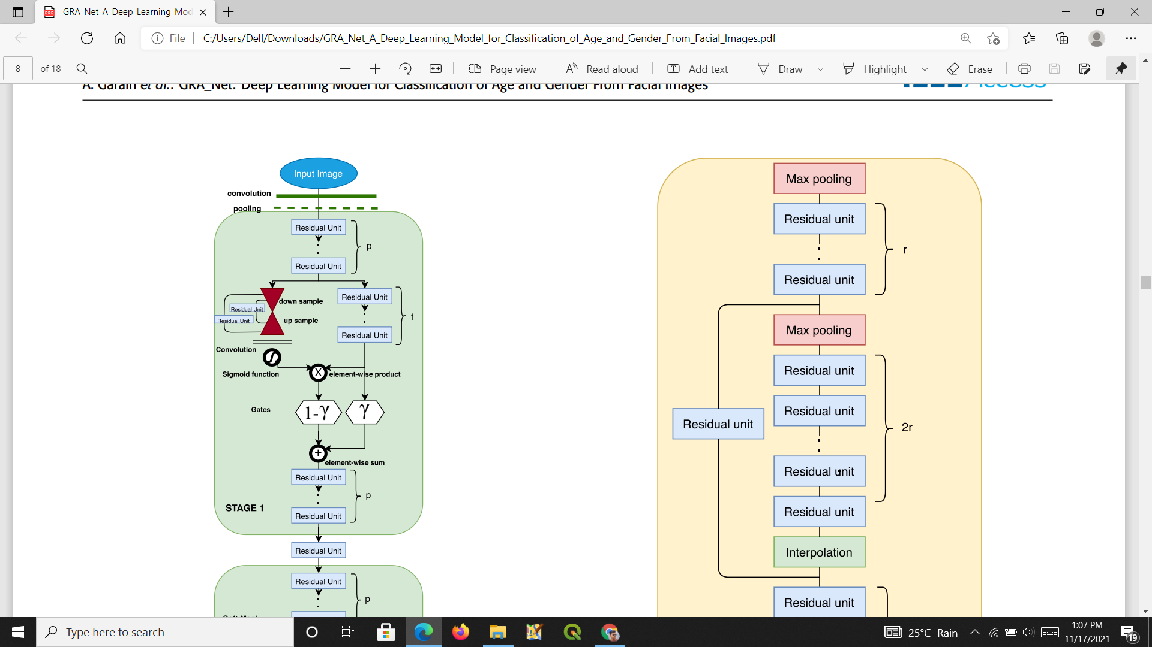
Overall architecture used in the present work for classification of age and gender from facial images

Slide 15
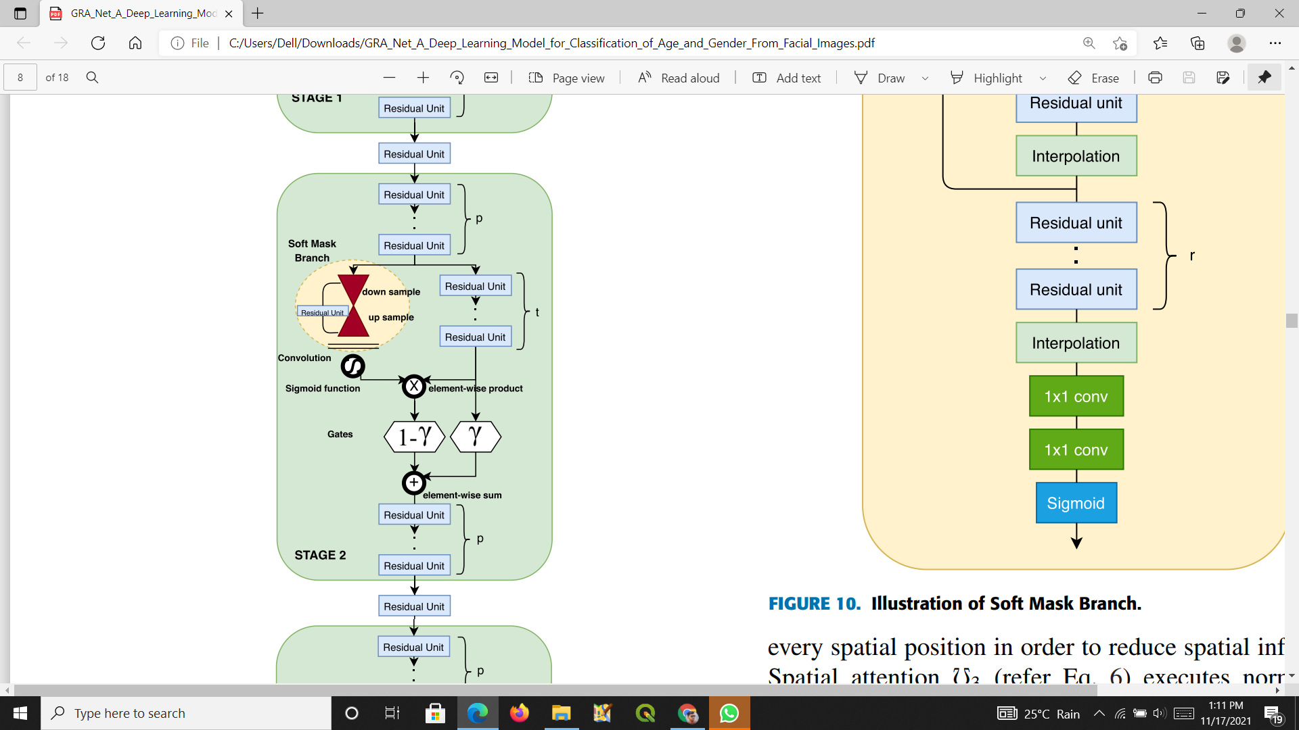

Slide 16
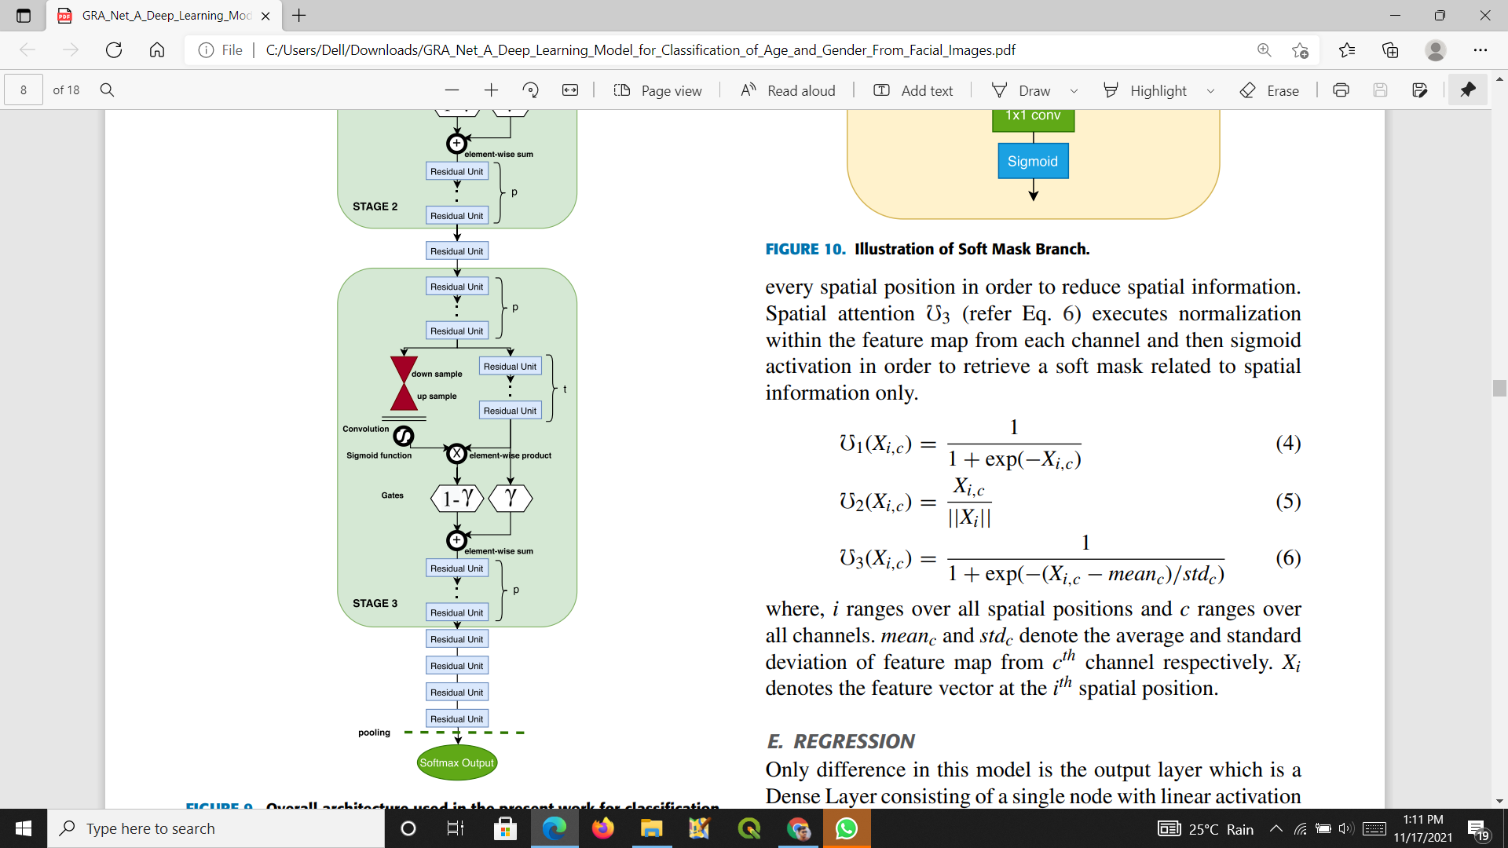

Slide 17
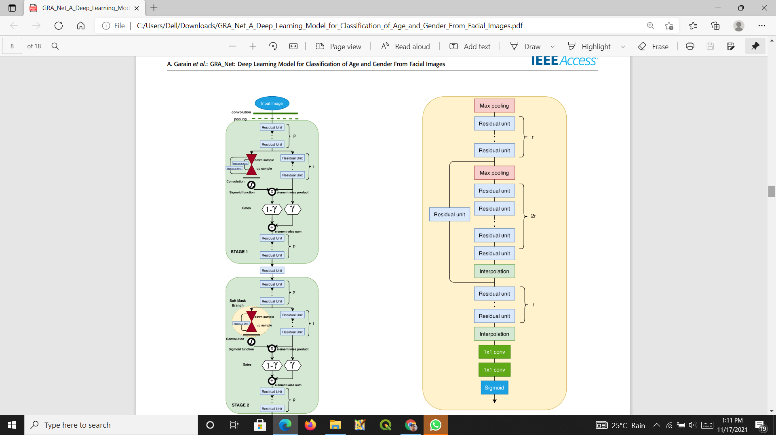
Illustration of Soft Mask Branch

Slide 18
REGRESSION
Only difference in this model is the output layer which is a Dense Layer consisting of a single node with linear activation and the labels being fed for training are the digits from 0 to 9.

Slide 19
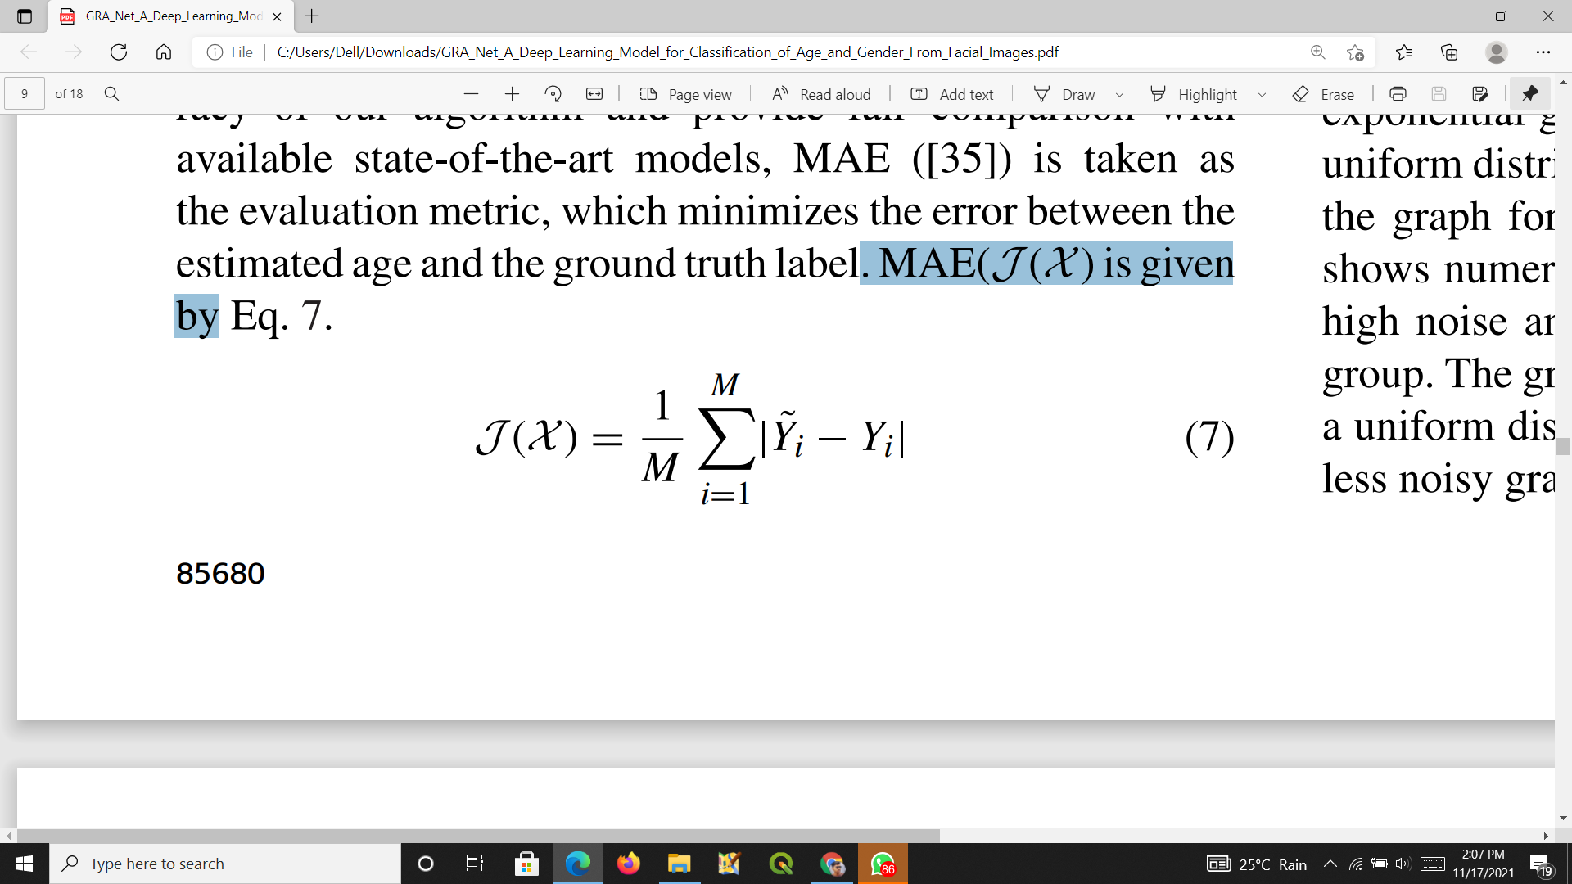
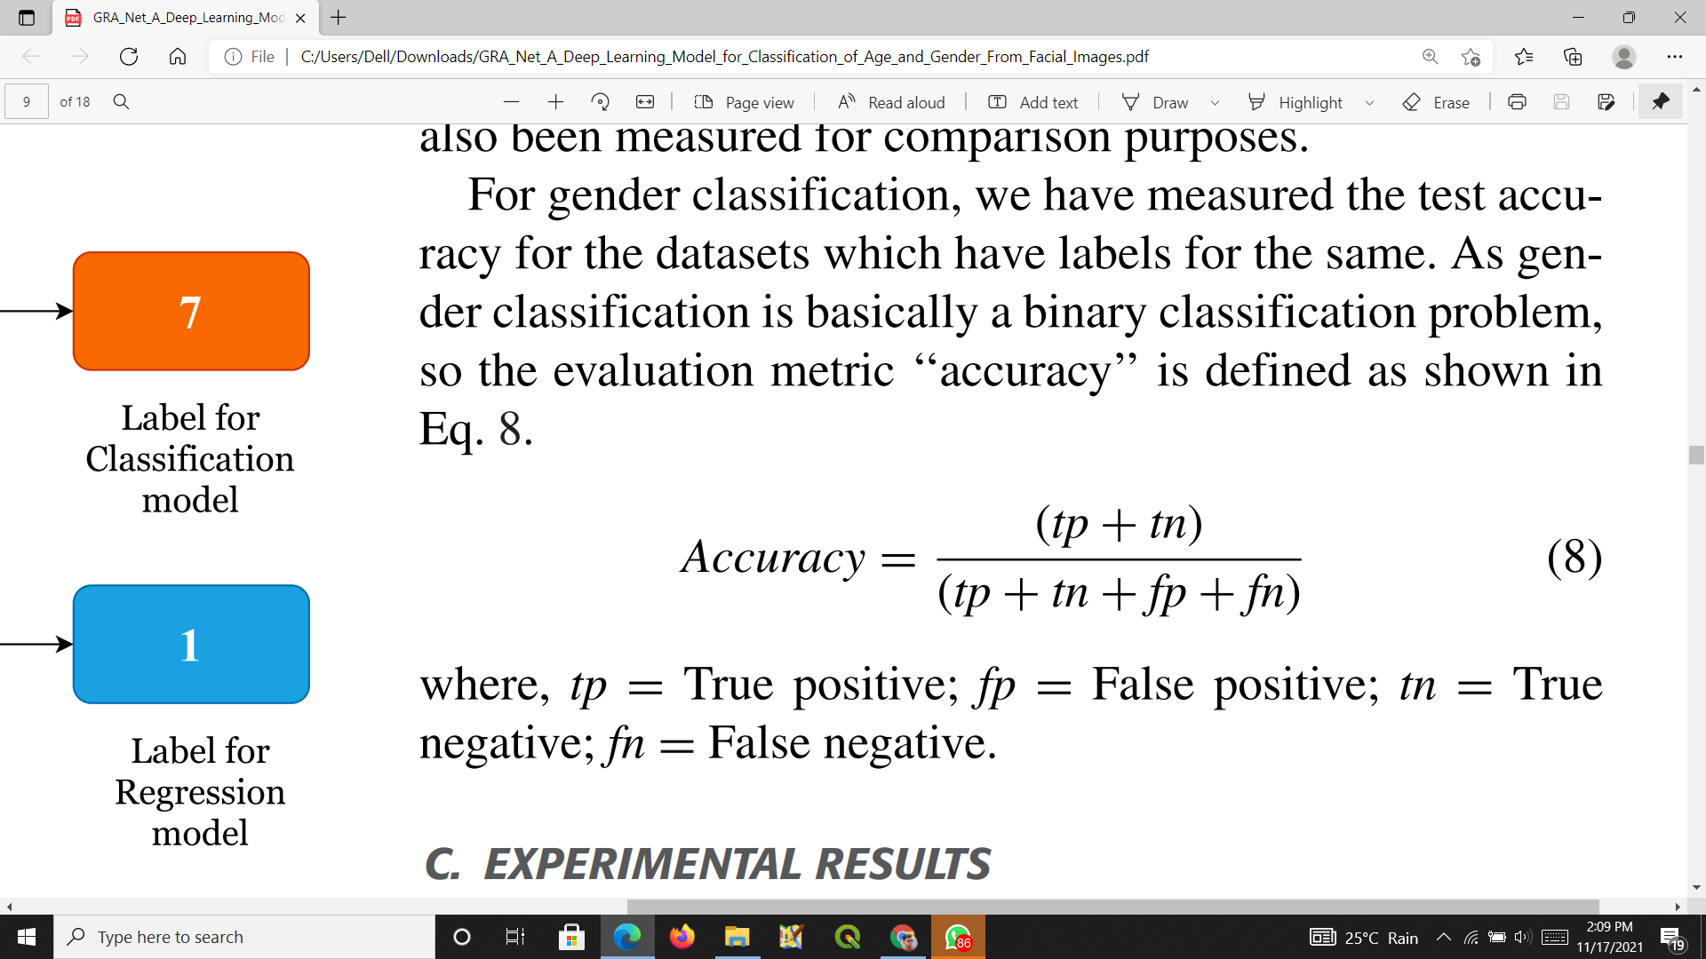
CONFUSION MATRIX
MAE(J (X ) is given by,
where, Y˜ i = True Age and Yi = Predicted Age for i th data point
where, tp = True positive; fp = False positive; tn = True negative; fn = False negative.

Slide 20
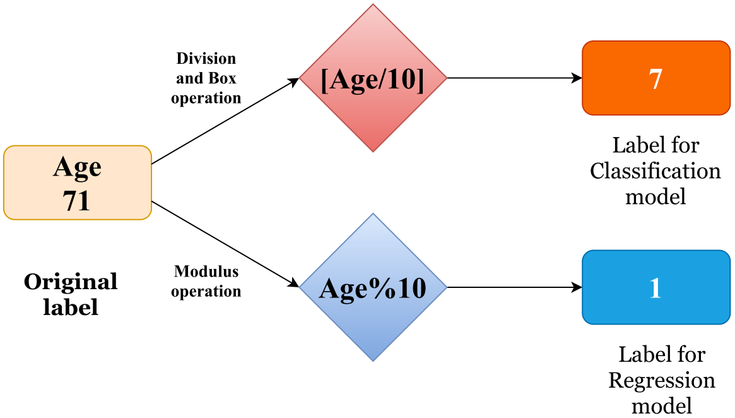
LABEL DIVISION

Slide 21
GENDER CLASSIFICATION
Classifying gender of small children is a very challenging task even for humans, thus leading to higher Bayesian errors for this class of images. The reason is that the masculine and feminine features start to become distinguishable only after reaching the age of puberty.

Slide 22
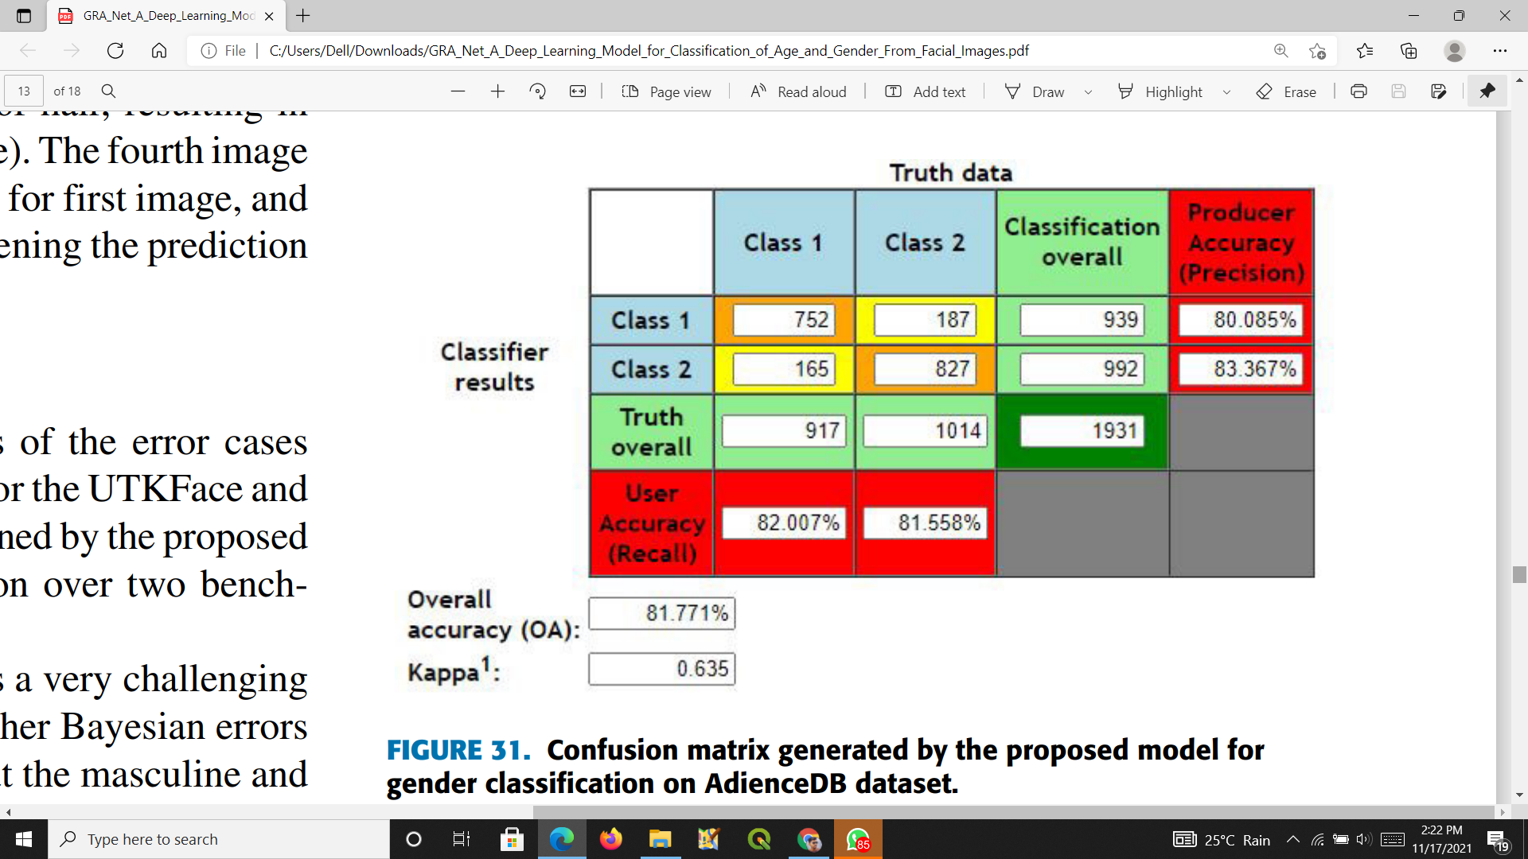
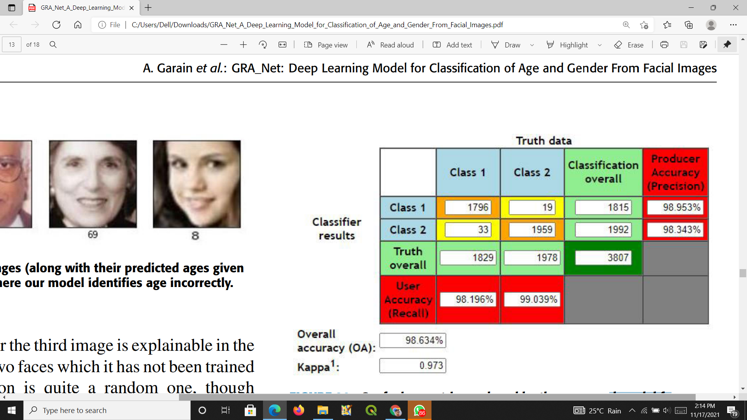
GENDER CLASSIFICATION (cont.)
Confusion matrix generated by the proposed model for gender classification on AdienceDB dataset.
Confusion matrix produced by the proposed model for gender classification on UTKFace dataset.

Slide 23
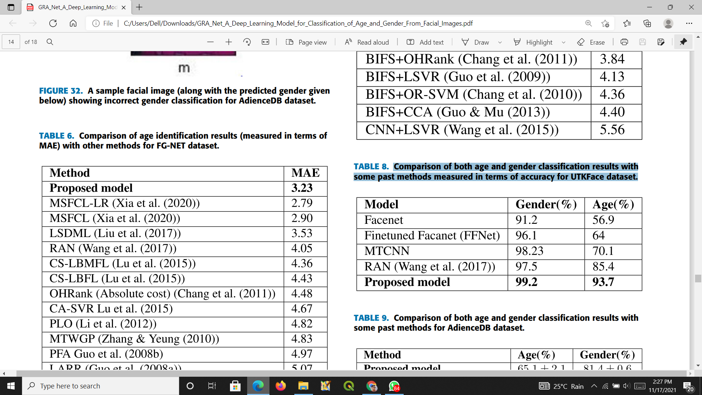
OLD MODELS
Comparison of both age and gender classification results with some past methods measured in terms of accuracy for UTKFace dataset.

Slide 24
CONCLUSION
There are still some rooms for improvement of the proposed model which can be done in the near future.
For example, we have to do more work while identifying the gender of kids as in the tender age both the male and female individuals have many commonalities in the facial features.
Also, our model needs to be more intelligent in estimating the age and gender when images are obstructive, partially viewed, bearing hat/glass/wig, and wearing some unusual make-up etc.

Slide 25
REFERENCES
GRA_Net: A Deep Learning Model for Classification of Age and Gender From Facial Images: https://ieeexplore.ieee.org/document/9446083
Deep Learning: https://searchenterpriseai.techtarget.com/definition/deep-learning-deep-neural-network
CNN: https://towardsdatascience.com/a-comprehensive-guide-to-convolutional-neural-networks-the-eli5-way-3bd2b1164a53

Slide 26
THANK YOU...

